Slide 1
PROJECT TITLE : GENDER DETECTION WITH COMPUTER VISION
Group Members:
Name: | No Matric :
Muhamed Hussain Bin Hithayatullah | B031810392
Muhammad Naim Syahmi Bin Roslan | B031810312
Rheshwan Raj A/L Ravichandran | B031810166
Ramanan Gobalakrishnan | B031810334

Slide 2
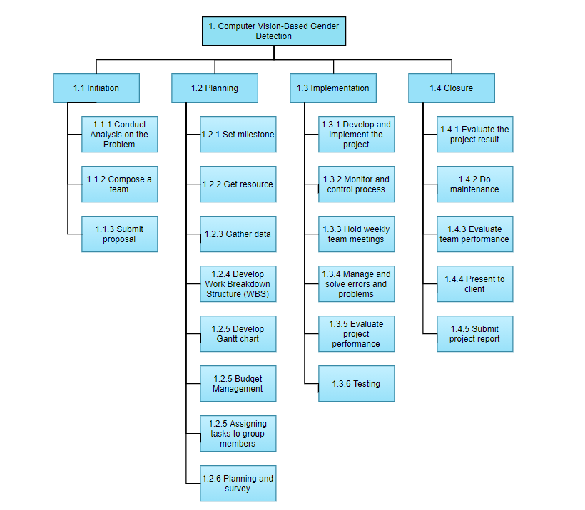
Work Breakdown Structure (WBS)

